Slide 1
Public Speaking Essentials
Start Your Journey

Slide 2
Attention
MMS sessions are 60-75 minutes followed by LONG Q&A
Please hold detailed questions until that Q&A starts
Feel free to ask clarification questions
Remind the speakers to use Zoom It when you can’t see

Slide 3




Adam Gross
Donnie Taylor
Microsoft MVP
Microsoft MVP
adamgrosstx
in/asquaredozen
donnietaylor
in/donnietaylor

Slide 4

Scott Corio
Microsoft MVP
dumpsterdave
in/scottcorio

Slide 5
Before we get to Before the Session
You have knowledge others don’t. And they want to hear it.
Yes you do. Knock it off.
Every.Single.Speaker. started somewhere
Why Not You?

Slide 6
Speaking By the Numbers
24
4
356
10,256
2 x 6 = 12
6 x 2 = 12
These are all Real Numbers

Slide 7

This is not a real number
$$\sqrt{−1}$$

Slide 8
Data needs visualizations

Slide 9
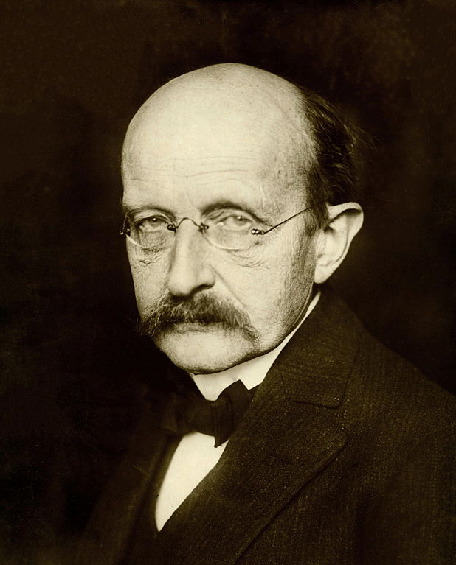
Quote Famous People

Slide 10
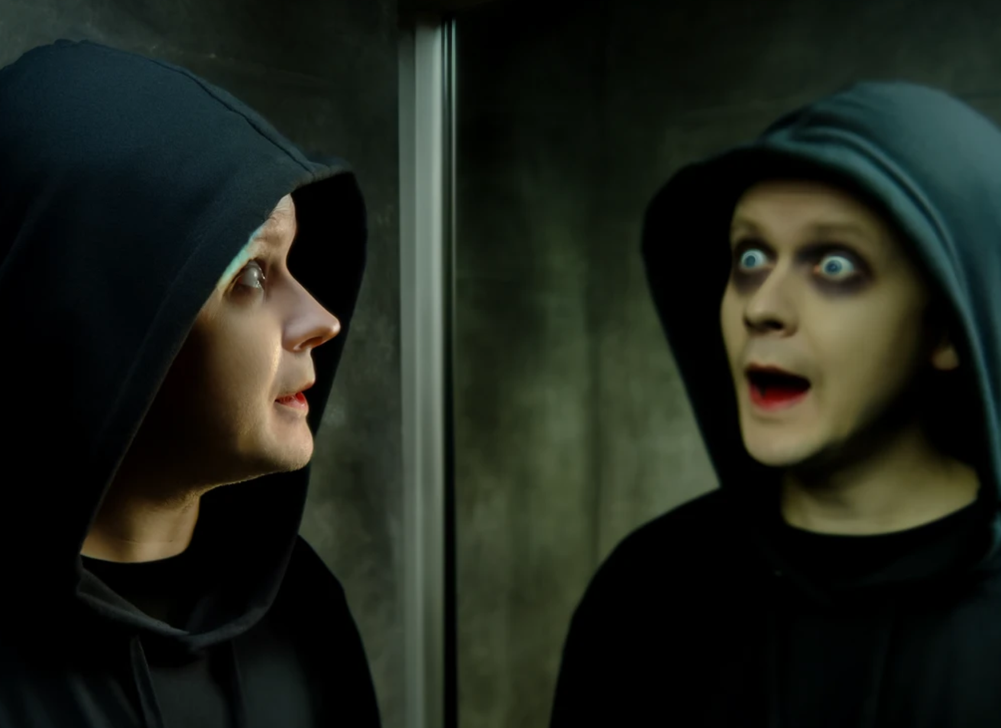

Before
Practice
Solo Practice
Small Audience
Kids
Pets
Rocks
Kidnapped Kids
Petnapped Pets
Rocknapped Rocks
That annoying coworker Brian and his stupid backpack
Scout the venue – Why?
Visualize the desired outcome
Learn breathing techniques

Slide 11

During
Start Strong
Quote, joke, or question are brilliant openers
Message, not Medium
Accept you will be nervous
DO NOT LOCK YOUR KNEES

Slide 12
After
Accept feedback – good or not so good
Examine what worked and what didn’t
Re-do, Re-work
Follow-Up

Slide 13
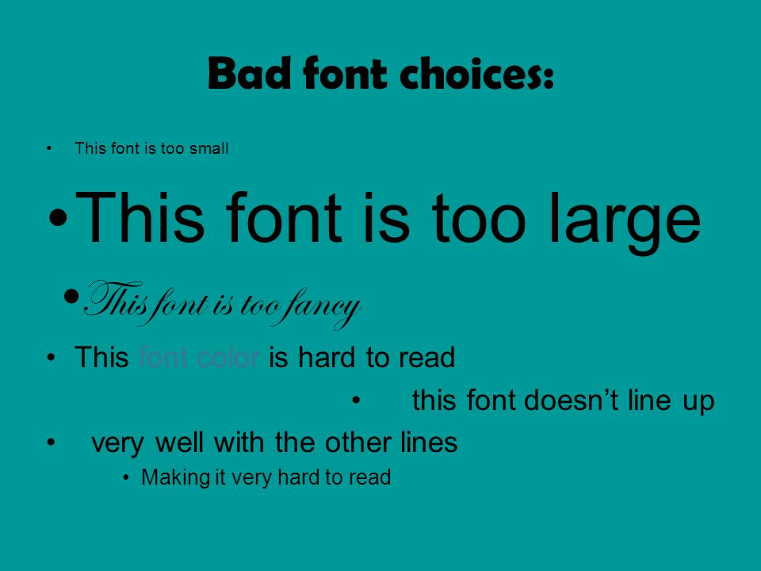
Design
Same Fonts
Same Colors
Similar Layouts

Slide 14
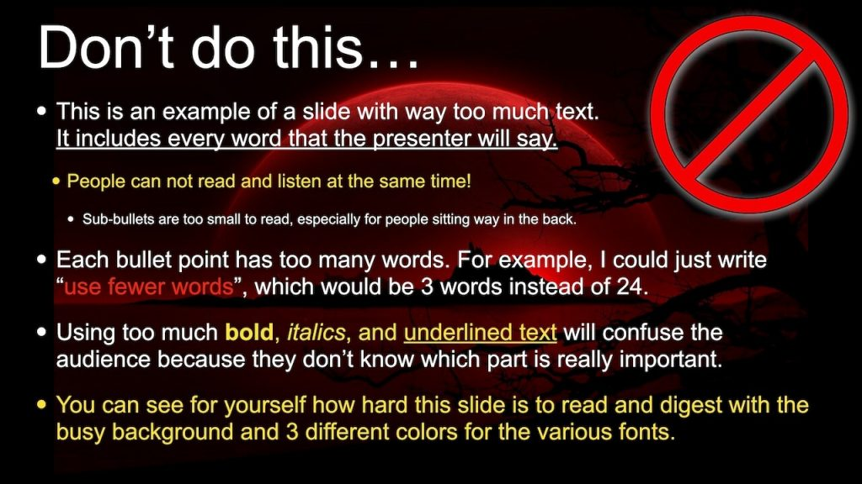
Simplify Your Slides
Keep the slides uncluttered
NO PARAGRAPHS

Slide 15
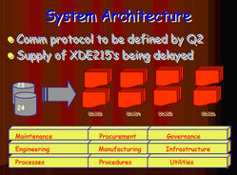
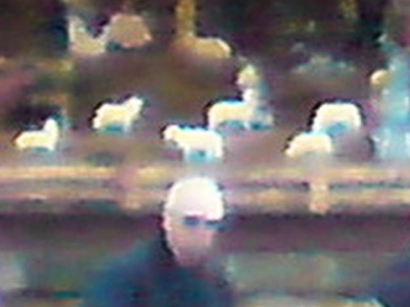
Effective Visuals
High Quality Images
Relative Images
Display complex information with charts, graphs, and infographics

Slide 16
Line Charts: For Diabetics that cant digest Pie… Charts

Slide 17
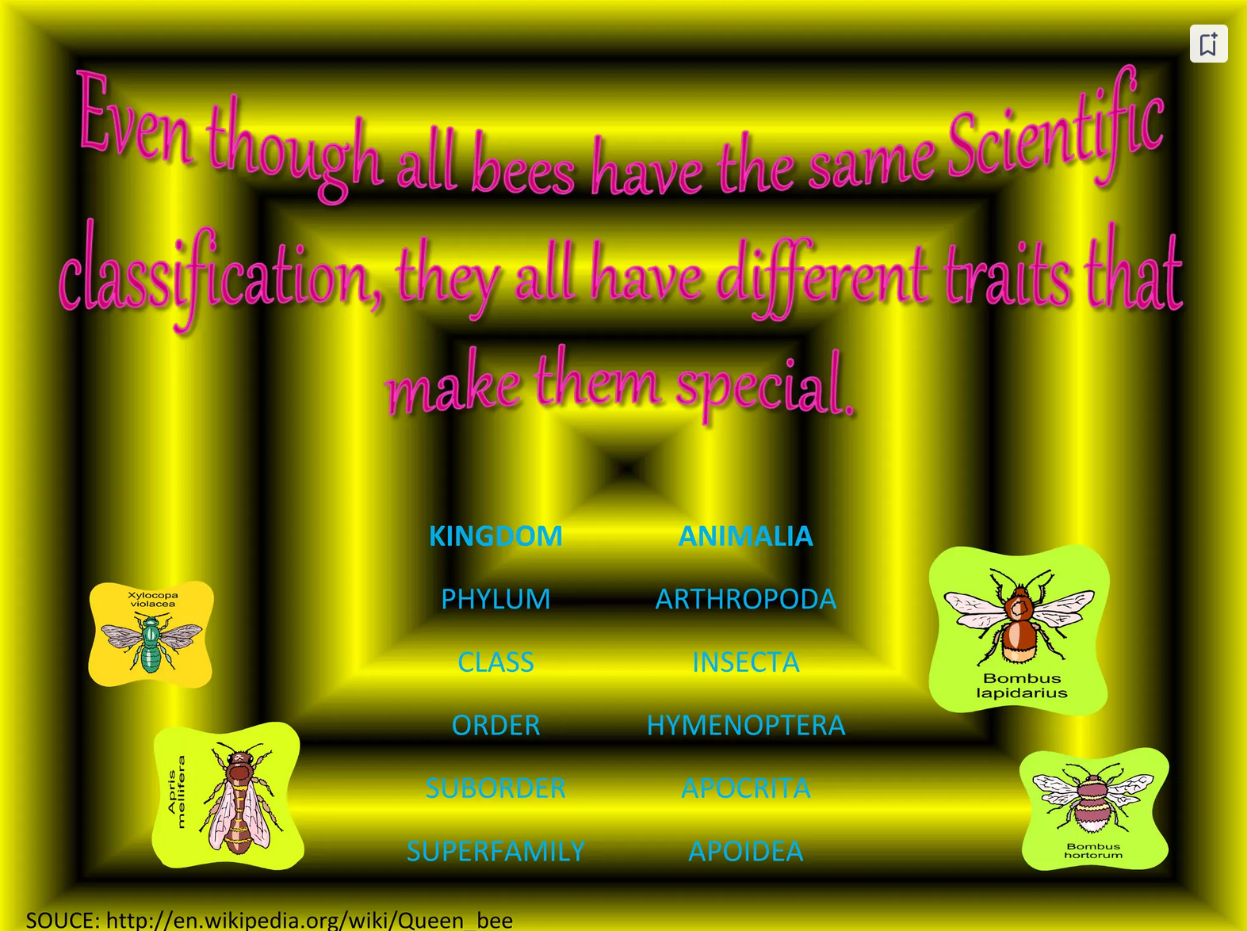
Can it be seen?
Use high contrast text and background colors
Large Fonts

Slide 18
Animations and Transitions
There is only one (or two) acceptable animations
Do NOT use videos
Animations are worth 1,000 Slides….. Nathan

Slide 19
Tell a story
Connect your content with a narrative
People remember stories, not facts
Relate content back to real-world applications
Keep your audience engaged

Slide 20
Keeping the Audience Awake
Start with a hook
Use Visual Aids
Interaction
Questions, polls
Read the room
Variance
Very your vocal pitch, pace, and volume
Use Pauses to your advantage
Eye Contact
Stories and Anecdotes
Humor
Keep it appropriate
Q&A!
End Strong
Follow-up Actions

Slide 21
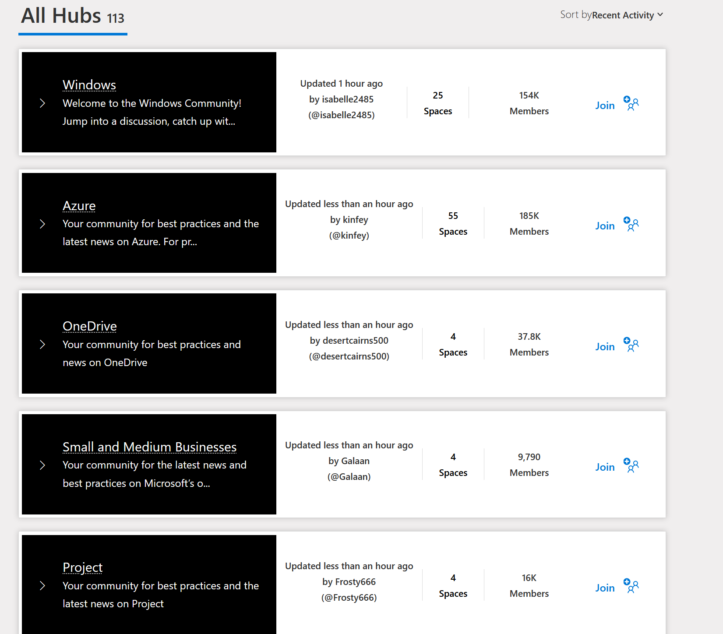
Opportunities
USER GROUPS
Microsoft Community Hub
Conferences
Hackathons and Tech Competitions
Social Media/Online Media
Start your own channel
Ask on Social Media
WinAdmins Discord!!
Networking
Tools

